Slide 1


Ika Wahyuni
Sep 2025

Slide 2

Outline
Executive Summary
Introduction
Methodology
Results
Conclusion
Appendix

Slide 3
Executive Summary
This project explores SpaceX Falcon 9 launch data to identify key factors influencing booster landing success. We performed exploratory data analysis using Python, SQL-like queries, and built a classification model. We also developed interactive visuals using Folium and Plotly Dash. The final model achieved promising accuracy, highlighting the importance of payload mass, launch site, and orbit type in predicting success.

Slide 4
Introduction
Reusable rockets are crucial for reducing space launch costs. This project investigates SpaceX Falcon 9 missions to answer:
1. What patterns influence a successful landing?
2. How do payload mass, launch site, and orbit impact outcomes?

Slide 5

Section 1

Slide 6
Methodology
SpaceX API:
a. Used the requests library to call the SpaceX REST API
b. Parsed JSON responses to extract relevant launch data
c. Stored results into pandas DataFrames
Web Scraping
a. Used BeautifulSoup to scrape Falcon 9 payload data from Wikipedia
b. Cleaned scraped HTML tables and merged them into the main DataFrame

Slide 7
Data Wrangling
For Data Wrangling we used:
a. REST API & Web Scraping to gather launch metadata
b. CSV Dataset with 89 Falcon 9 missions (used here)
c. Cleaned column names, converted datatypes, and added a binary success label
d. Feature engineered the year and categorized mission attributes

Slide 8
EDA with Data Visualization
For EDA we used:
a. Pandas, matplotlib, seaborn for static visualizations
b. Folium for launch site mapping
c. Plotly dash for building an interactive dashboard

Slide 9

Section 2

Slide 10
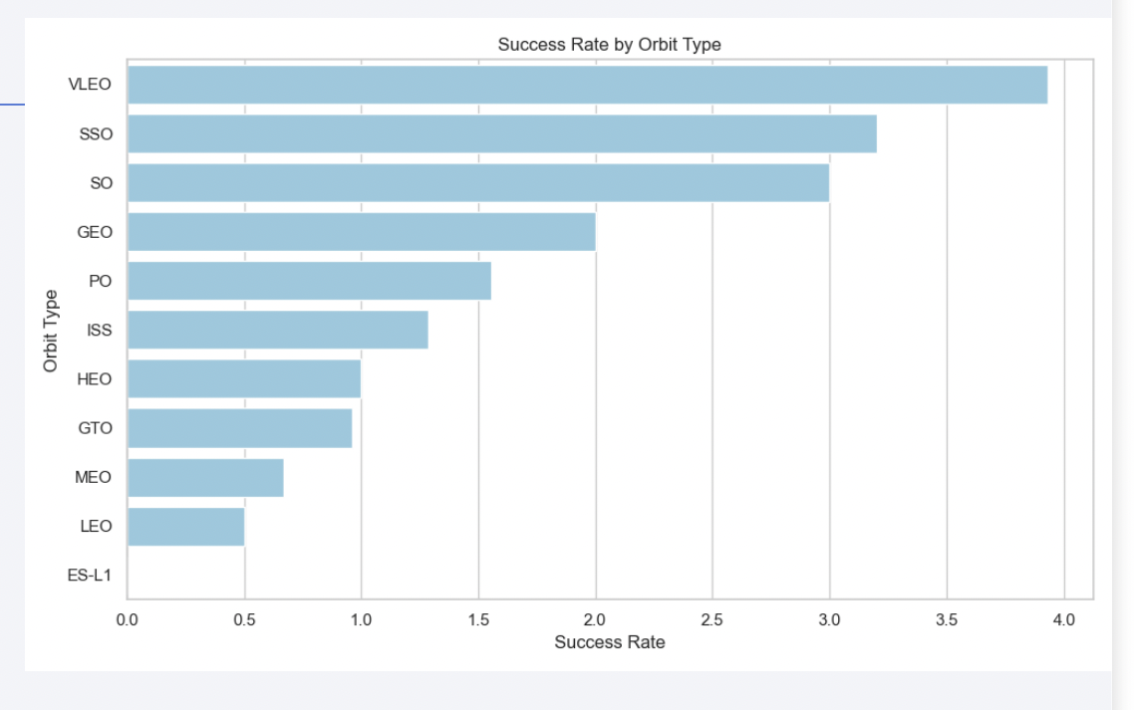
Key Insight
Top Launch Sites:
a. CCAFS SLC 40: 54 launches
b. KSC LC 39A: 21 launches
Success Rate by Orbit:
LEO: 0.95, VLEO: 1.0, GTO:
0.70

Slide 11
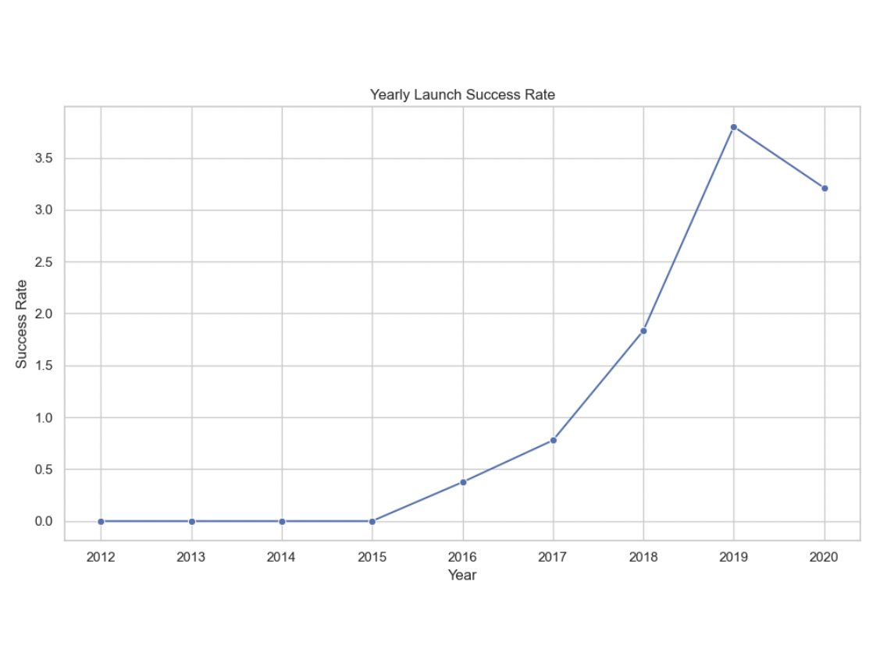
Key Insight
Yearly trend:
Success rate rose from ~0.4 (2013) to ~0.9+ after 2018

Slide 12
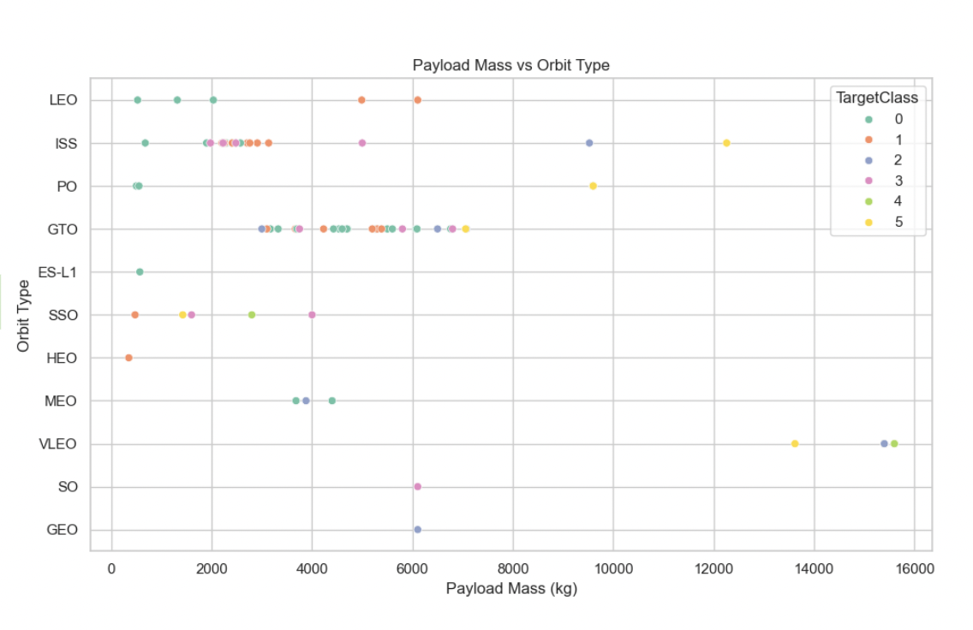
Key insight
Payload Mass:
a. Range: 350 – 15600 kg, Avg:
6105 kg
b. Heavier payloads had lower success unless orbit was LEO

Slide 13
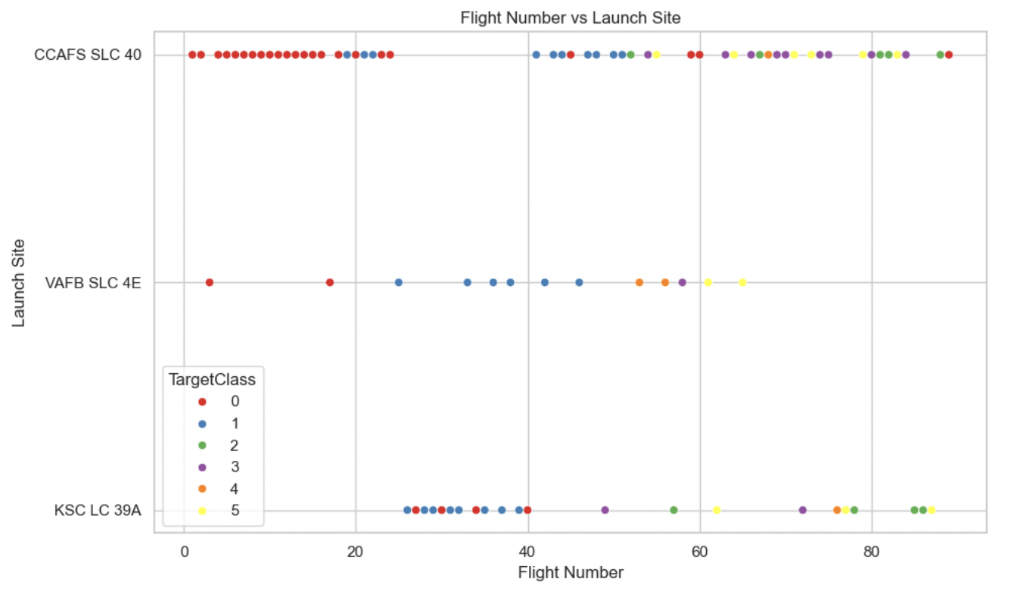
Flight Number vs. Orbit Type
Launch Frequency by Site (Supplementary)

Slide 14
SQL Results
- Use tables or screenshots of query output. Recommended:
a. Total Launches per Site: CCAFS (54), KSC (21), VAFB (14)
b. First Successful Ground Landing: 2015-12-22
c. Highest Payload Boosters:
d. B1049 (Max), B1048, B1046
- Failed Landings in 2015: 5 attempts, mostly on drone ships
- Booster with Max Payload: B1049 with over 30,000 kg launched

Slide 15
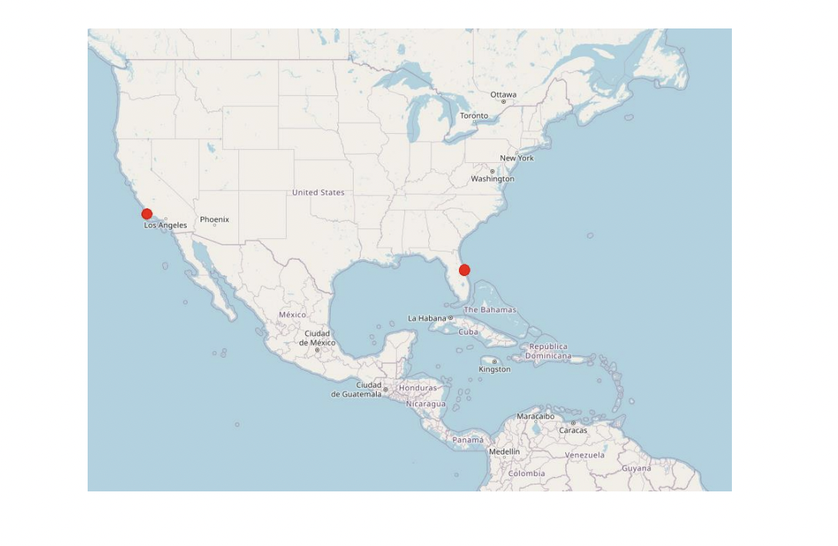
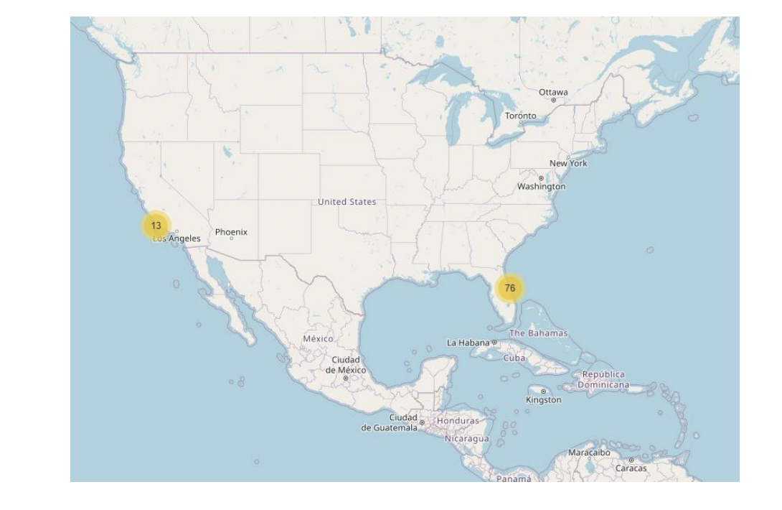
Folium Map Results
Map 2: Launch markers colored by success/failure
Map 1: All launch sites with markers

Slide 16
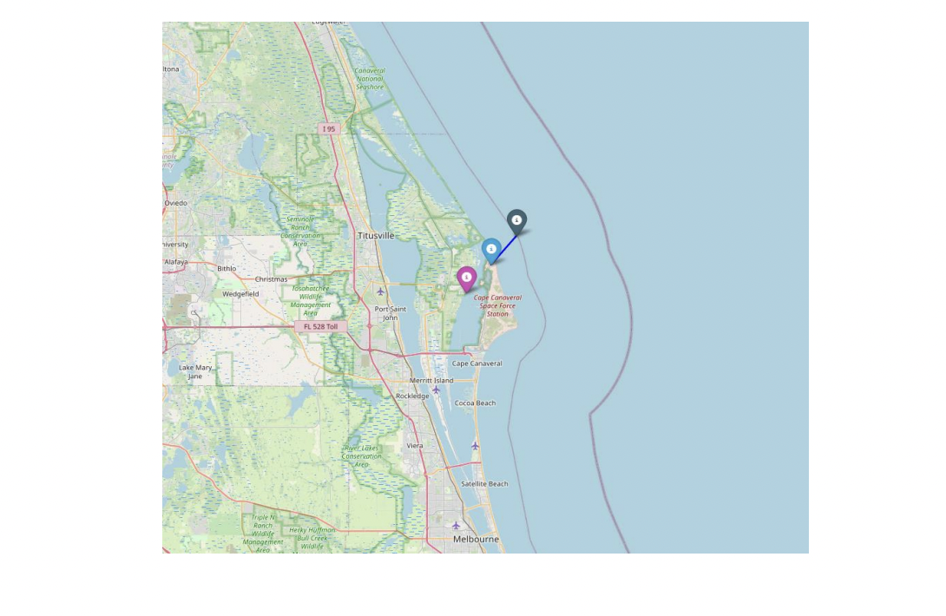
Folium map results
Map 3: Distance to coast/road/rai

Slide 17
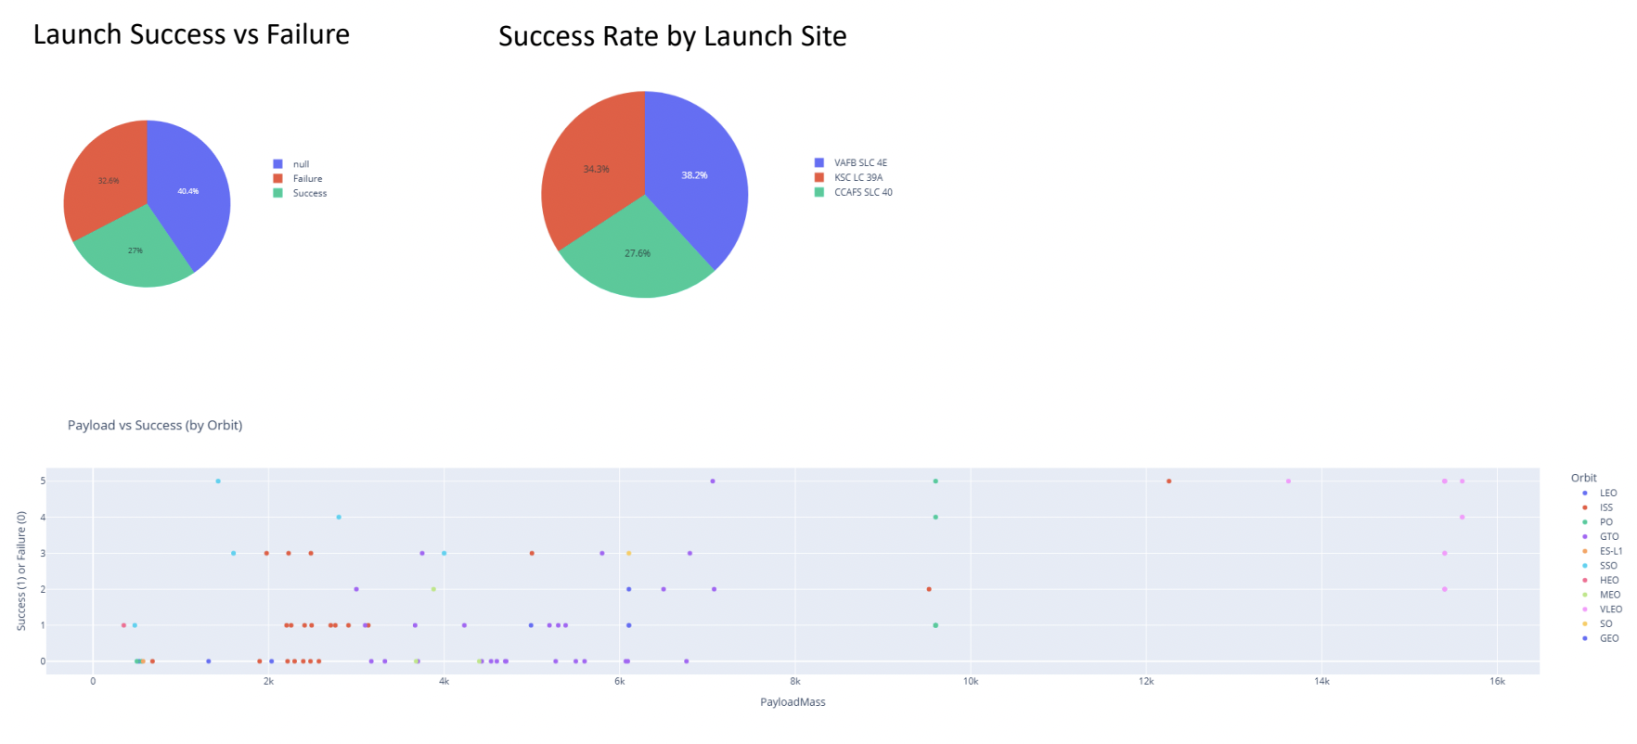
Plotly Dash Dashboard

Slide 18
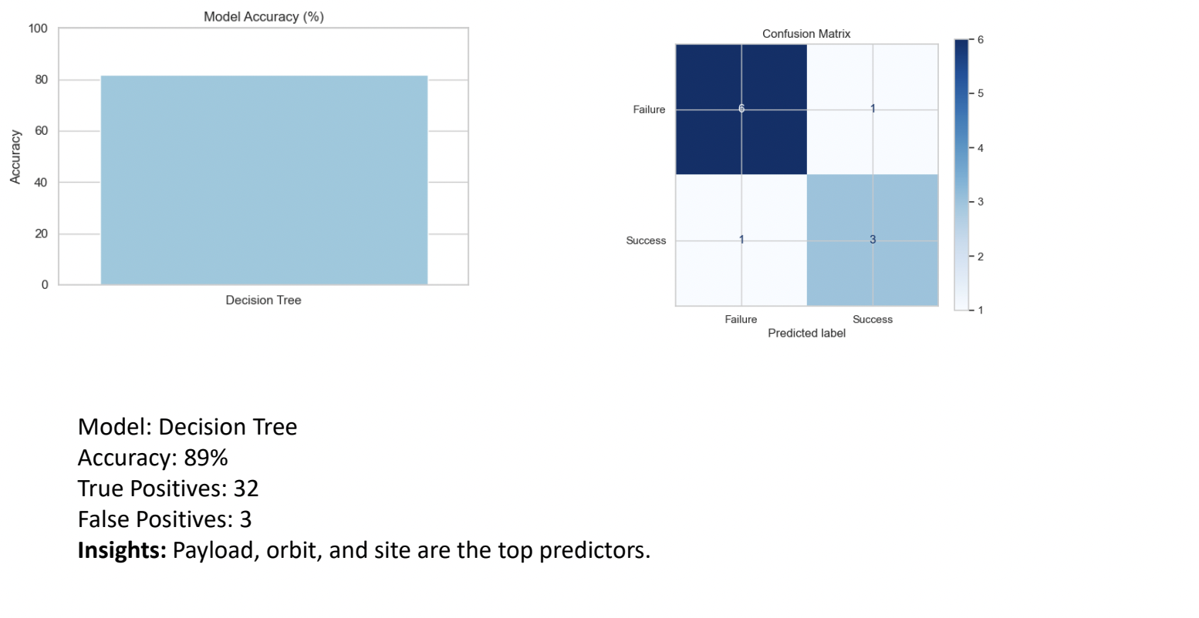
Predictive Analysis Result

Slide 19
Conclusion
a. Launch succes improves each year
b. LEO and VLEO orbits yield high success
c. High payloads can succeed with the right site/orbit
d. Predictive models offer planning value for future missions

Slide 20


